Slide 1
Weekly Update 3
Sarang Deb Saha
1

Slide 2
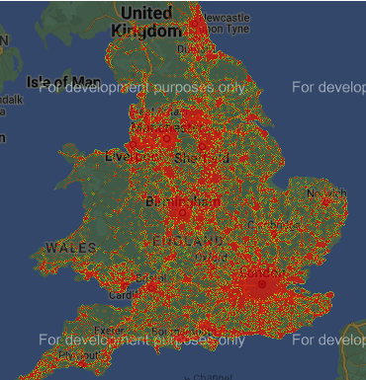
Continued work:
Mapping all of the accidents in UK from 2005-2015 using the Gmap API.
Can be replicated for Bengaluru now
2

Slide 3
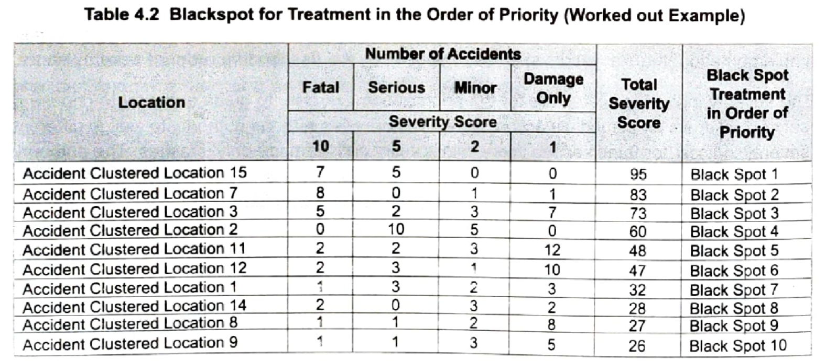
Relating with previous week’s study
3

Slide 4
Paper referred:
Goyal, Aman, et al. "Detecting, tracking and counting motorcycle rider traffic violations on unconstrained roads." Proceedings of the IEEE/CVF Conference on Computer Vision and Pattern Recognition. 2022.
IIIT Hyderabad
Rahman, Zillur, Amit Mazumder Ami, and Muhammad Ahsan Ullah. "A real-time wrong-way vehicle detection based on YOLO and centroid tracking." 2020 IEEE Region 10 Symposium (TENSYMP). IEEE, 2020.
Chittagong University of Engineering and Technology (CUET)
4

Slide 5
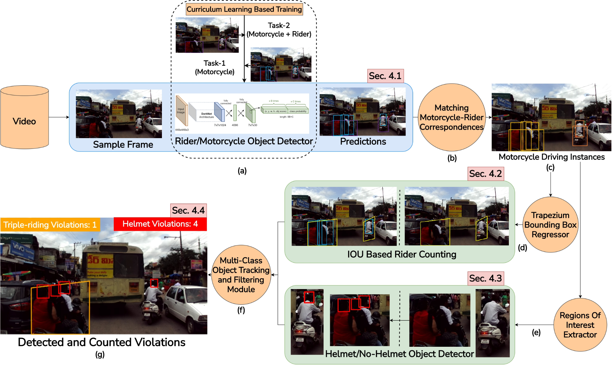
"Detecting, tracking and counting motorcycle rider traffic violations on unconstrained roads."
5

Slide 6
According to a World Health Organization study, 1.35 million fatalities each year where 50% of them are caused due to two-wheeler vehicles. This number further rises for densely populated Asian countries.
Tackling the problems of: i) Triple-riding violations and ii) Helmet Violations
Static cameras may not be present on the majority of the streets. Installing cameras everywhere may not be an economically viable and sustainable solution. Therefore, adopting an approach that operates on videos from a dashboard camera mounted within a police vehicle.
A novel trapezium representation for identifying triple riding violations
6

Slide 7
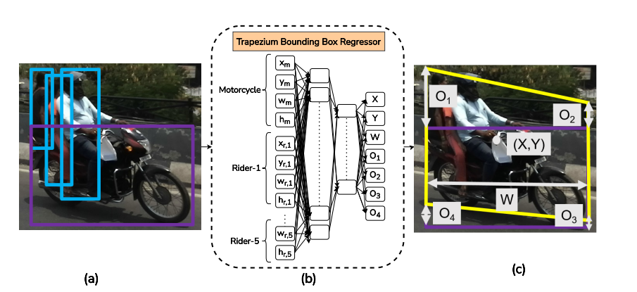
Data collected from India Driving Dataset (IDD) extracted by selecting images with motorcycles and riders, followed by filtering out small bounding boxes based on an area threshold of 900 squared pixels, as low-resolution boxes add noisy samples to the training data.
Curriculum Learning used utilizes the curriculum learning-based object detector to obtain robust detections of motorcycles and riders and avoid inter-class confusion due to high overlap between the bounding boxes of the two classes. The object detector further helps in robustly predicting triple riding and helmet violations.
Drawing rectangular boxes over such correlated riders and motorcycles also becomes an issue, as in many
cases, a significant portion of such boxes cover the background area and intersect with riders of other motorcycles.
7

Slide 8
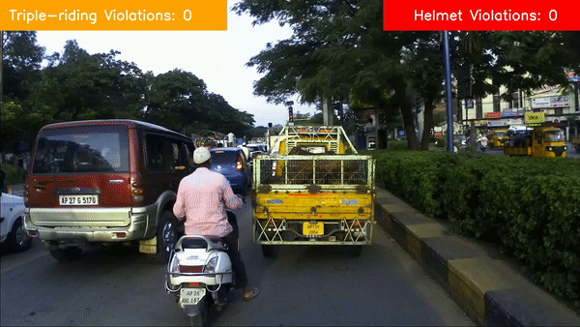
Data Description and Results
A dataset of 1281 images containing 907 riders without helmets and 98 instances of triple-riding violations amongst 3313 riders and 4573 motorcycles.
70:30 as a train:test split for the model.
3) A practical system should
have high precision or low false positives, as it is not appropriate to call a non-violator a violator.
The proposed architecture achieves precision,
recall, and F-score of i) 100.00%, 80.00% and 88.88% for
triple rider violation and ii) 87.50%, 63.63% and 73.67%
for helmet violation on the demo video.
8

Slide 9
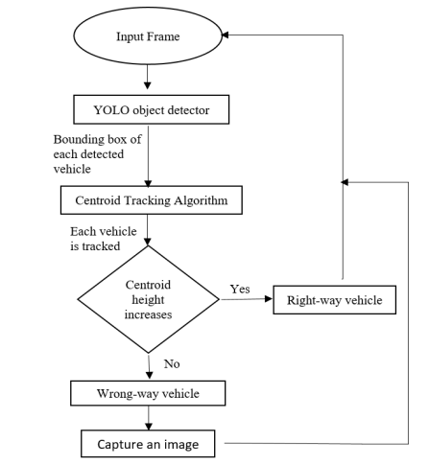
2. "A real-time wrong-way vehicle detection based on YOLO and centroid tracking."
9

Slide 10
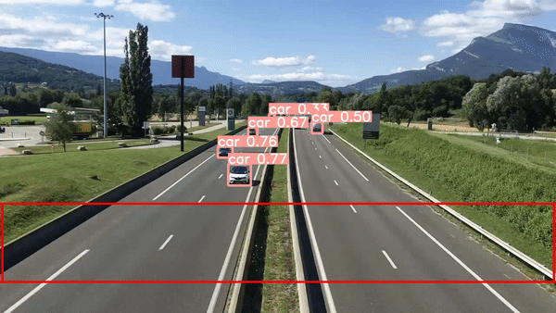
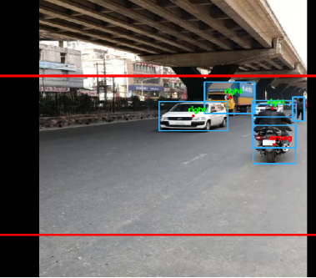
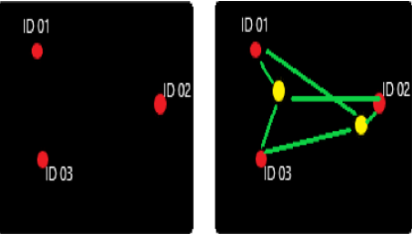
If H1 < H2 then, the vehicle is coming
towards the camera and is in the right way.
Else, the system will detect it as a wrong-way vehicle.
10

